Slide 1

DRIVER DROWSINESS DETECTION

Slide 2
TEAM MEMBERS
Harish Krishna – 19bcs064
Lakshya jain – 19bcs068
Sibi s – 19bcs070
Hisham ahmed – 19bcs071

Slide 3
OVER THE YEARS – EYE DETECTION SYSTEM
2012
NOT IMPLEMENTED
IMPLEMENTED BUT FAILED
2019
HAD MAJOR DRAWBACKS
2016

Slide 4
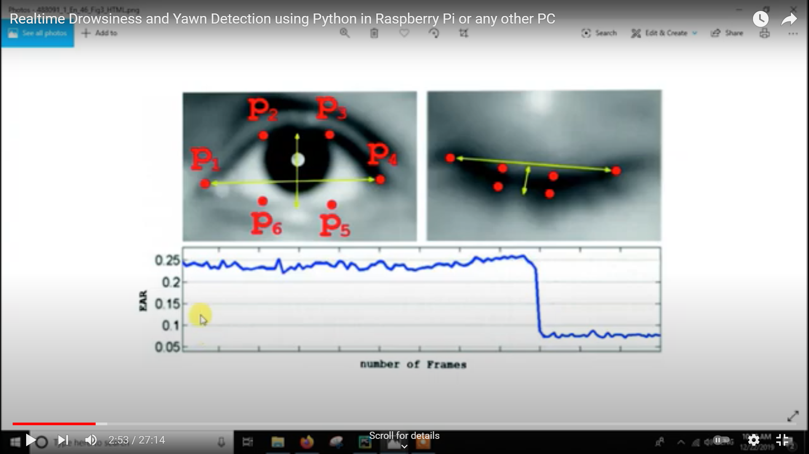

Slide 5
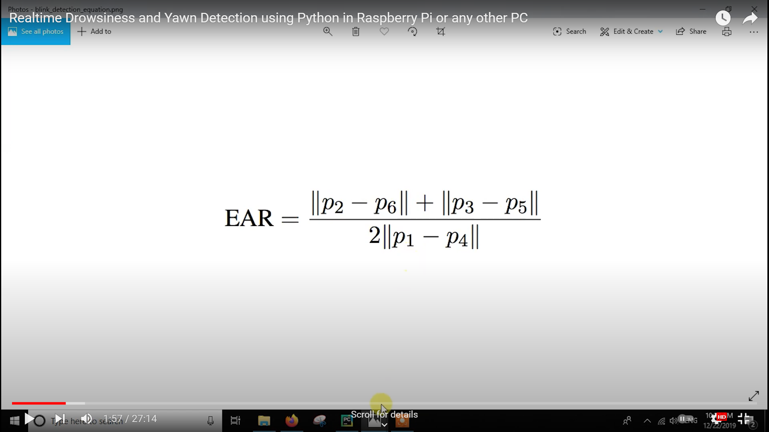

Slide 6
